Slide 1
Respiratory syncytial virus: recently developed rsv vaccines
In The Name Of God
Supervisor: dr.Tehrani
By: ali rahmati

Slide 2
Respiratory syncytial virus
RSV is one of the most common pathogens causing acute lower respiratory tract infection (LRTI), particularly in infants, the elderly, and immunocompromised individuals
Globally, RSV affects approximately 64 million people and causes 160,000 deaths annually
Newborns are particularly vulnerable to RSV infection due to:
1.their immune system is underdeveloped with immature dendritic cells and low antiviral cytokine levels, which delay effective immune responses.
2.infants are vulnerable to airway blockage resulting from RSV-induced inflammation due to their physical characteristics, such as weak respiratory muscles, soft tracheobronchial cartilage, and short airways.
Additionally, while maternal antibodies offer some protection, they do not completely prevent infection.
The severity of RSV infection in elderly individuals is affected by a variety of factors.
A key factor is immunosenescence, which impairs T and B cell function and weakens antiviral immune responses. Additionally, the presence of common comorbidities such as chronic obstructive pulmonary disease (COPD) and cardiovascular diseases can exacerbate the consequences of RSV infection.
The aging respiratory system is characterized by reduced alveolar elasticity and impaired ciliary action

Slide 3
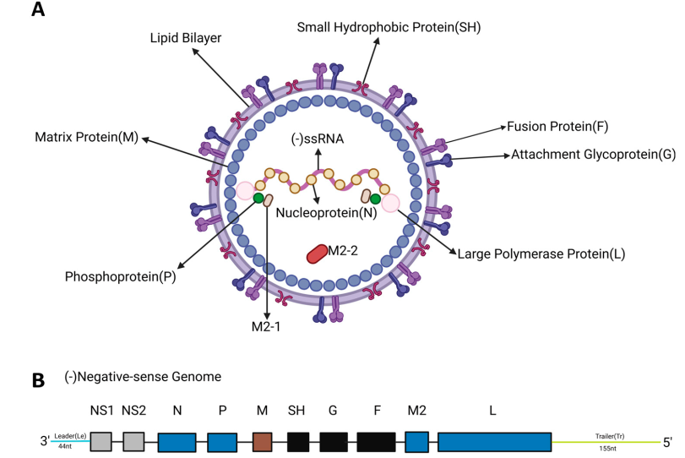



Structural and genomic organization of RSV
The F and G glycoproteins are both transmembrane proteins that are highly glycosylated and mediate viral entry
F protein directs virus-cell and cell-cell fusion. It presents multiple neutralizing epitopes and can elicit potent neutralizing antibody responses, making it a primary vaccine target & Due to its high level of conservation among RSV strains, it is the main vaccine target antigen
G protein contains a central conserved region that facilitates viral attachment by interacting with cell surface heparan sulfate receptor
the G protein contains a central conserved domain (CCD) with a low degree of glycosylation and the presence of a CX3C motif. This CX3C motif is necessary for G protein to mimic the chemokine fractalkine and bind to the host CX3CR1 receptor
Notes:
RSV is classified under the order Mononegavirales, the family Pneumoviridae, and the genus Orthopneumovirus. This virus is a non-segmented negative-strand RNA virus. The genome of RSV has an approximate length of 15.2 kb and comprises 11 open reading frames, which encode 9 structural proteins (F, G, N, P, M, SH, L, M2-1, and M2-2) and 2 non-structural (NS) proteins

Slide 4
Early Rsv vaccine research
Natural RSV infection does not provide long-term immunity, leading to frequent reinfections.
Early FI-RSV (formalin-inactivated RSV) vaccine (1960s) caused enhanced respiratory disease (ERD) in RSV-naïve infants. Formalin inactivation altered the prefusion F (PreF) protein, resulting in poor induction of neutralizing antibodies.
Non-neutralizing antibodies failed to protect and, in some cases, worsened disease after natural RSV infection.
Two ERD-related deaths in 1967 delayed RSV vaccine development and led to stricter FDA regulations.
Sub-neutralizing antibodies bind RSV without neutralizing it. Antibody–virus complexes enhance viral entry into immune cells via Fcγ receptors.
Complement activation and excessive inflammation increase tissue damage.
Modern RSV vaccines are designed to induce strong neutralizing antibodies while minimizing the risk of ERD/ADE.

Slide 5
Rsv vaccines strategies
Two predominant strategies for RSV vaccine development:
Subunit vaccines are formulated using specific proteins (subunits) of the virus instead of the complete viral entity and are devoid of viral genetic material. Such vaccines typically incorporate the F protein of RSV or other immunogenic proteins, which can stimulate the body to produce an immune response.
The advantage of subunit vaccines lies in their favorable safety profile, as the absence of live viruses eliminates the risk of vaccine-induced infection. This characteristic makes them suitable for prophylactic immunization in target populations such as pregnant women and the elderly
Particle-based vaccines, particularly virus-like particles (VLP)

Slide 6
Subunit Vaccines: Abrysvo (RSVPreF)
Abrysvo (Pfizer) is a bivalent prefusion F (PreF) protein subunit vaccine designed to protect against both RSV-A and RSV-B.
Approved by the FDA in 2023 for:
Maternal immunization (pregnant women)
Adults aged ≥60 years
Each dose contains 120 µg of stabilized prefusion F protein (60 µg from RSV-A and 60 µg from RSV-B).
The vaccine antigen is produced in Chinese hamster ovary (CHO) cells and engineered to maintain the prefusion (PreF) conformation, which elicits potent neutralizing antibodies.
Clinical Efficacy
MATISSE Phase III Trial (Maternal Vaccination)
Reduced severe RSV-associated lower respiratory tract infection (LRTI) in infants by:
81.8% within the first 90 days after birth.
69.4% within the first 180 days after birth.

Slide 7
Subunit Vaccines: Abrysvo (RSVPreF)
ACIP/GRADE Assessment
Overall efficacy against RSV-associated LRTI: 51.3%.
Efficacy increased to 57.3% when vaccination was administered during the recommended 32–36 weeks of gestation.
Older Adults (≥60 years)
Demonstrated 75–82% effectiveness in preventing RSV-related hospitalization.
Also showed protective benefits in immunocompromised individuals and patients with end-stage renal disease (ESRD).
Safety and Immunogenicity
Phase I/II and Phase III clinical trials demonstrated a favorable safety profile.
Induced high levels of RSV-neutralizing antibodies.
Provides protection for newborns through transplacental maternal antibodies and directly protects older adults.
Notes:
Abrysvo اثربخشی بالایی در پیشگیری از عفونت RSV، به‌ویژه در زنان باردار و سالمندان، نشان داده است.
در زنان باردار:
با واکسیناسیون مادر، نوزاد از بدو تولد از طریق انتقال آنتی‌بادی‌های مادری محافظت می‌شود.
خطر بستری ناشی از عفونت‌های دستگاه تنفسی تحتانی LRTI) ) مرتبط با RSV در نوزادان به‌طور قابل‌توجهی کاهش می‌یابد.
اگرچه احتمال اندکی برای زایمان زودرس و اختلالات پرفشاری خون بارداری گزارش شده است، اما ACIP این خطرات را در صورت تزریق واکسن بین هفته‌های ۳۲ تا ۳۶ بارداری قابل قبول می‌داند.
در سالمندان:
به دلیل ایمنی و اثربخشی مطلوب، ACIP واکسیناسیون را برای تمام افراد ۷۵ سال و بالاتر و همچنین افراد ۶۰ تا ۷۴ سال که در معرض خطر بالای بیماری شدید RSV هستند، توصیه می‌کند.

Slide 9
Arexvy (RSVPreF3): A Prefusion RSV Vaccine
Arexvy is a GSK-developed RSV vaccine approved by the FDA in May 2023.
It is designed to prevent RSV-related lower respiratory tract infection (LRTI) in older adults.
Main antigen: RSVPreF3, a recombinant prefusion F protein stabilized in the PreF conformation.
Adjuvant: AS01E, which enhances immunogenicity and immune activation.
AS01E contains:
MPL: a TLR4 agonist
QS-21: saponin-based immune stimulator
liposomal delivery with DOPC and cholesterol

Slide 10
Why AS01E Improves Vaccine Performance
AS01E induces broader and stronger neutralizing antibody responses. It activates innate immunity through TLR4 signaling.
It promotes:
polyclonal B-cell activation
antibody affinity maturation
stronger immunity against RSV-A and RSV-B
It also supports Th1-biased CD4+ T-cell responses and cytokine production such as:
IFN-γ
IL-2
TNF-α
Compared with alum, AS01E provides:
better cellular immunity
improved cross-presentation
stronger responses in the elderly

Slide 11
Clinical Efficacy, Safety, and Key Takeaways
In adults 60+, a Phase III trial showed: 82.6% efficacy against RSV-confirmed LRTI
94.1% efficacy against severe RSV-LRTI
Protection remained meaningful across at least two RSV seasons. In adults 50–59 with risk factors, immune responses were comparable to older adults. Common side effects: injection-site pain
fatigue
headache
Serious adverse events were similar to placebo in trials. Main caution: possible GBS risk
cold-chain storage required at 2–8°C

Slide 12
DS-Cav1: a prefusion-stabilized RSV F subunit vaccine
DS-Cav1 is a prefusion RSV F protein vaccine candidate developed by NIH/NIAID. It was designed because most potent neutralizing antibodies after natural RSV infection target the prefusion F (PreF) form. The most important vulnerable neutralizing regions are antigenic sites Ø and V. DS-Cav1 was engineered to stably preserve the PreF conformation and expose key neutralizing epitopes.

Slide 13
How DS-Cav1 stabilizes the Ø site
DS mutation: introduction of S155C-S290C creates a disulfide bond that helps prevent conversion from PreF to PostF. Cav1 mutation: S190F-V207L fills a hydrophobic cavity and makes the membrane-distal head more ordered. The DS-only variant is relatively unstable against temperature and pH changes. The combined DS-Cav1 design showed the best balance of: structural order
production yield
resistance to temperature, pH, osmotic stress, and freeze-thaw cycles
Electron microscopy showed a homogeneous DS-Cav1 protein population.

Slide 14
Early clinical evidence and maternal immunization potential
In a Phase I trial, 95 participants received DS-Cav1 with or without alum at weeks 0 and 12.
The vaccine was safe and well tolerated at doses up to 500 µg.
A single dose produced persistent virus-neutralizing activity through follow-up.
DS-Cav1 also showed potential for maternal immunization, with efficient transfer of RSV-specific IgG from mother to infant.
This raises the possibility of protecting infants during the first 6 months of life.

Slide 15
Key limitations of DS-Cav1
DS-Cav1 still has stability limitations during storage and depends on the cold chain.
After storage at 4°C, binding to some PreF-specific antibodies declines markedly.
In aged mice, DS-Cav1 induces much weaker humoral and cellular immunity than in young mice.
Even with GLA-SE adjuvant, improvement in elderly-like immune responses remains limited.
These findings may explain why DS-Cav1 has not progressed to late-stage trials in older adults

Slide 16
DT-PreF: a highly stable RSV prefusion subunit vaccine
DT-PreF is an RSV subunit vaccine candidate developed by Calder Biosciences.
It is a stable mutant of RSV prefusion F (PreF).
Its key innovation is the use of dityrosine (DT) bonds instead of conventional disulfide bonds.
DT bonds are zero-length covalent cross-links with very high chemical stability.
This “post-folding modification” helps stabilize the native PreF structure while reducing risks of:
misfolding
abnormal aggregation

Slide 17
Structural design and epitope preservation
DT-PreF contains two engineered dityrosine bonds:
V185Y–N428Y → stabilizes the IV/V interface
K226Y–Y198 → locks the major neutralizing Site Ø
These modifications keep key neutralizing epitopes exposed and prevent PreF-to-PostF transition.
Additional foldon mutations:
L512V
L513V
Y519F
These changes further improve trimer stability without blocking epitope access.

Slide 18
Exceptional thermostability and reduced cold-chain dependence
DT-PreF shows much greater stability than DS-Cav1.
Melting temperature (Tm) is 78°C:
+25°C vs uncross-linked PreF
+17°C vs DS-Cav1
After 11 weeks at 4°C, DT-PreF preserves prefusion structure and immunogenicity.
At 25°C for 7 days, DT-PreF retains 85% of prefusion conformation, while DS-Cav1 retains only 42%.
In transport simulation, DT-PreF maintained 90% prefusion purity.
After opening, it remains usable for 72 hours at 4°C, which may reduce vaccine waste.

Slide 19
Preclinical efficacy and current limitations
DT-PreF has not yet entered clinical trials. In animal studies, it showed strong protection: sterile lung protection in cotton rats
potent responses against both RSV-A and RSV-B
In mice, DT-PreF induced 11-fold higher neutralizing antibody titers than DS-Cav1. In aged mice, higher antigen dose helped overcome immunosenescence without requiring stronger adjuvants. Main limitation: lack of human clinical data
future approval timeline remains uncertain

Slide 20
ADV110 (BARS13): an RSV G-protein subunit vaccine
ADV110 (BARS13) is a recombinant protein subunit RSV vaccine developed by Advaccine.
Unlike most RSV vaccines, it targets the G protein, not the F protein.
The RSV G protein functions as the viral attachment protein.
ADV110 aims to prevent RSV infection by targeting a more structurally independent neutralizing region of G protein.
It is formulated with the novel adjuvant AE011.

Slide 21
Targeting the CCD/CX3C region of RSV G protein
ADV110 is designed around the central conserved domain (CCD) of RSV G protein.
This region includes the CX3C motif, which binds to CX3CR1 on respiratory epithelial cells.
Antibodies against this domain may show:
strain-independent activity
interference with viral attachment and entry
The vaccine also includes cyclosporin A (CsA) in its design.
Proposed immune effect:
induction of neutralizing antibodies
induction of antigen-specific Tregs
reduced excessive T-cell activation

Slide 22
Immunogenicity and clinical findings
In BALB/c mice, ADV110 induced a dose-dependent antibody response.
Even very low doses were able to generate detectable antibodies.
Vaccinated mice showed significantly reduced lung viral load.
In Phase II clinical data:
both low-dose and high-dose groups showed higher IgG levels than placebo
antibody levels increased further by day 60
two-dose regimens produced stronger responses than early single-dose time points
Phase II data suggest good safety and immunogenicity in adults aged 60–80 years.

Slide 23
Potential advantages and key concerns
Potential advantages:
novel G-protein targeting strategy
may reduce risk of vaccine-enhanced disease (VED)
controlled T-cell activation through AE011
Safety profile was generally acceptable:
common adverse effects included fatigue, headache, myalgia, discomfort
Key concern:
Treg induction may be a double-edged sword
too much immune suppression could reduce:
Th1/CTL responses viral clearance
long-term immune memory
Overall, ADV110 is a promising but immunologically unconventional RSV vaccine candidate.

Slide 24
Particle-Based Vaccines (VLPs) in RSV
Virus-like particles (VLPs) are self-assembling multi-protein complexes structurally similar to viral capsids.
They lack genetic material, so they cannot replicate or infect cells.
In RSV, VLPs are designed as non-replicating nanoparticles approximately 80–400 nm in size.
VLPs can induce both humoral and cellular immune responses.
Compared with conventional subunit vaccines, they provide denser epitope display and stronger antibody reactivity.

Slide 25
Design Logic and Immunological Advantages
RSV VLPs typically display prefusion F protein trimers and membrane-anchored G glycoproteins with preserved CX3C motifs.
Two major assembly strategies are used:
RSV M protein-based assembly
Heterologous scaffold platforms such as HIV Gag or NDV chimeras
Their optimal size (80–300 nm) supports efficient lymphatic trafficking and dendritic cell uptake.
Repetitive antigen presentation strongly enhances B-cell activation.
VLPs co-displaying F + G proteins may provide broader and more durable neutralization than F-only vaccines.

Slide 26
What Is IVX-A12?
IVX-A12 is a bivalent VLP-based vaccine developed by Icosavax.
It is designed to prevent lower respiratory tract infections caused by:
RSV
human metapneumovirus (hMPV)
The vaccine combines two components:
IVX-121 targeting RSV
IVX-241 targeting hMPV
The RSV component, IVX-121, is based on the prefusion F (PreF) conformation of RSV F protein.
IVX-A12 is one of the most advanced combined RSV/hMPV vaccine candidates.

Slide 27
Clinical Evidence, Strengths, and Limitations
Phase II data showed strong immune responses against both RSV and hMPV.
RSV-A/B neutralizing antibodies increased by 2- to 6-fold, with GMT reaching about 12,200 IU/mL.
hMPV-A/B antibodies increased by about 2.3- to 4-fold.
The vaccine was generally well tolerated, with a favorable safety profile.
Key limitations include:
complex manufacturing
higher production cost
need for confirmation in Phase III
uncertain long-term durability and real-world effectiveness

Slide 28
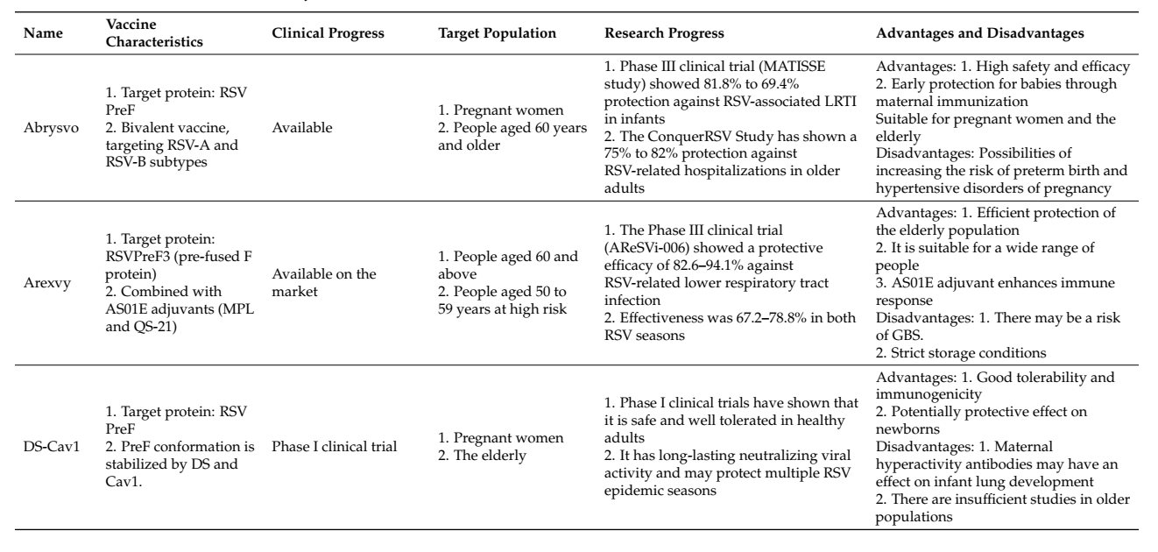
Summary of subunit RSV vaccines

Slide 29
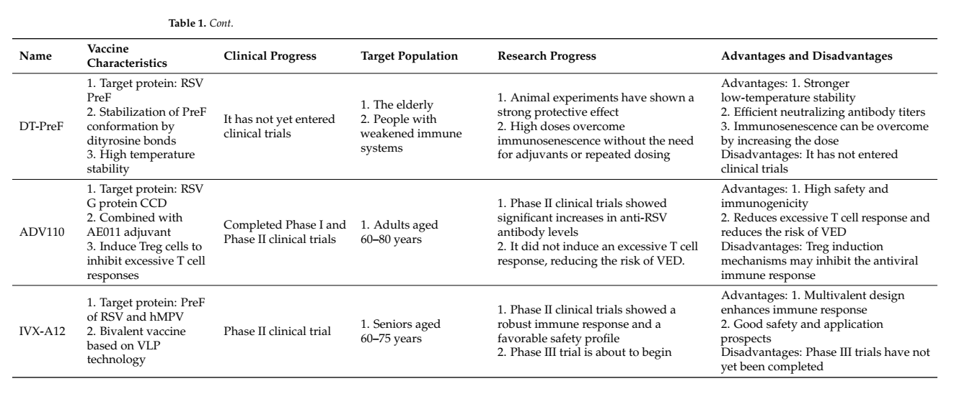
Summary of subunit RSV vaccines

Slide 30
Thanks For Your Attention

